Slide 1
Image Categorisation II
By Julian Stefinovic(100136806) & Adrian Yong (100122248)

Slide 2
Classifiers

Slide 3
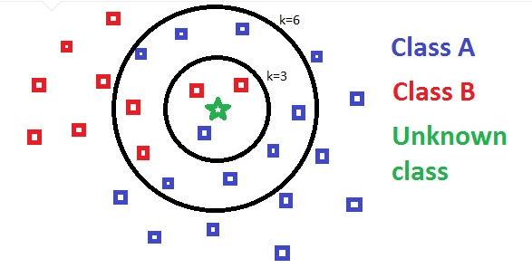
KNN
The KNN algorithm operates as follows:
Compares the test image to all the images in the dictionary and finds the smallest difference between the features.
The images with k smallest feature differences are categorised
The highest scoring category is assigned to the image in question
The figure below (Sanjay, 2018) gives a visual representation of the KNN algorithm .

Slide 4
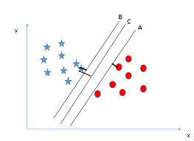
SVM
Hyperplane (line) separates the two types of feature.
Looks for the largest margin between the data points and hyperplane.
1 vs All Model
Experiments done with:
Lambda/Max Number of Iterations
Bias Multiplier
Epsilon
Loss Function

Slide 5
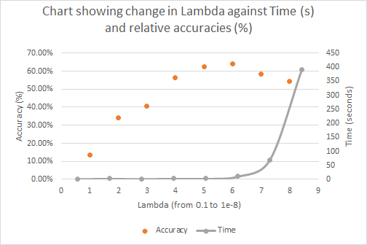
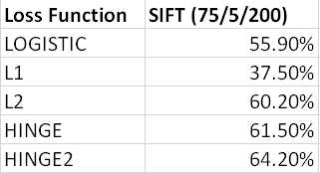
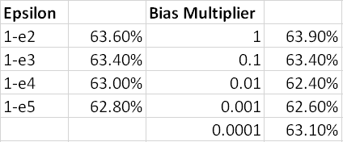
SVM
Loss Function SIFT (75/5/200)
LOGISTIC 55.90%
L1 37.50%
L2 60.20%
HINGE 61.50%
HINGE2 64.20%

Slide 6
Features

Slide 7
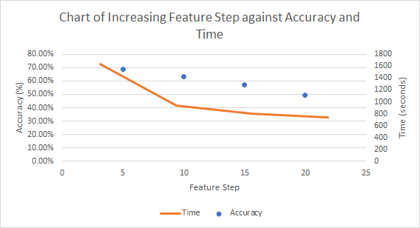
Bag of SIFT
Experiments executed with grayscale and colour images.
Feature Step changed from range 5-20 in intervals of 5
Vocab Step changed from 25-100 in intervals of 25
Vocab Size changed from 50-300 in intervals of 50

Slide 8
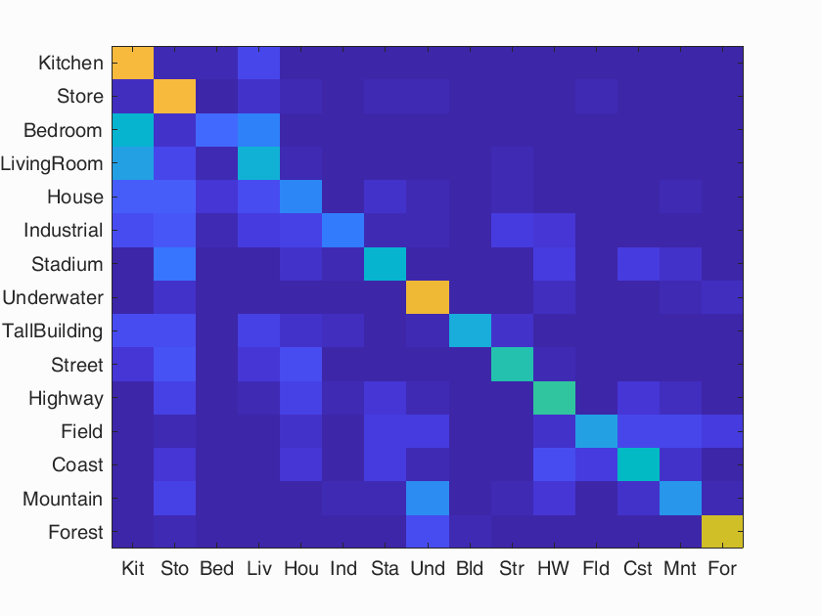
Bag of SIFT with grayscale images (KNN)
Accuracy: 50.0%
Strongest Cat: Underwater: 81%
Weakest Cat: Bedroom: 21%

Slide 9
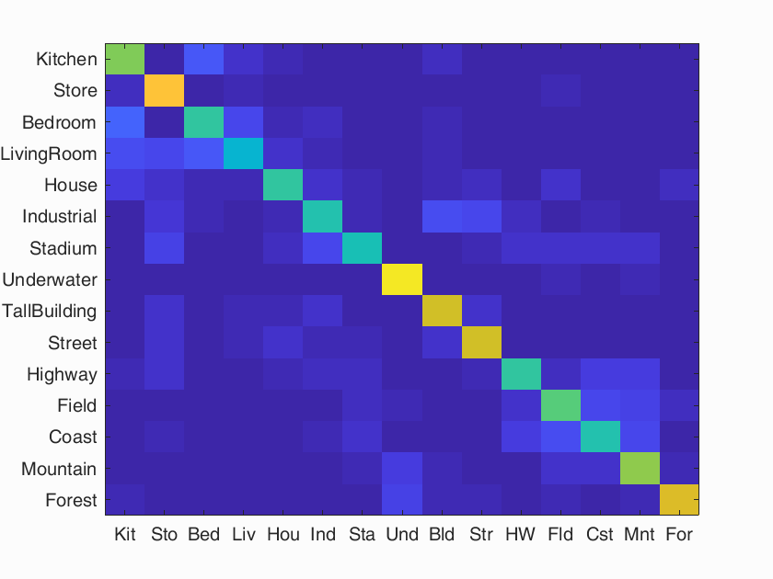
Bag of SIFT with grayscale images (SVM)
Accuracy: 64.6%
Strongest Cat: Underwater: 94%
Weakest Cat: Living Room: 45%

Slide 10
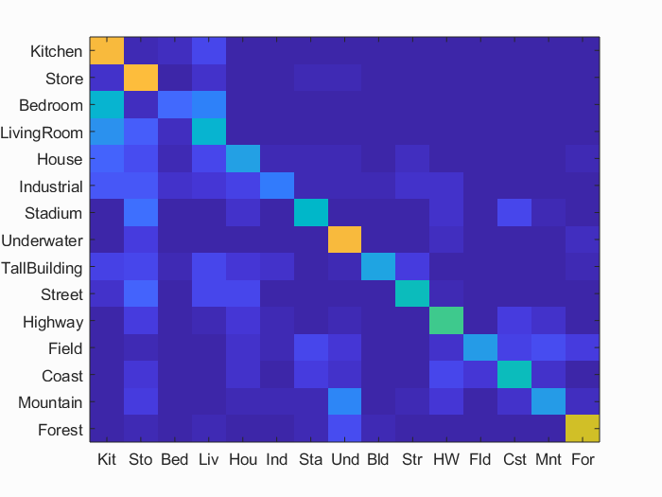
Bag of SIFT with colour images (KNN)
Accuracy: 50.7%
Strongest Cat: Store: 84%
Weakest Cat: Bedroom: 21%

Slide 11
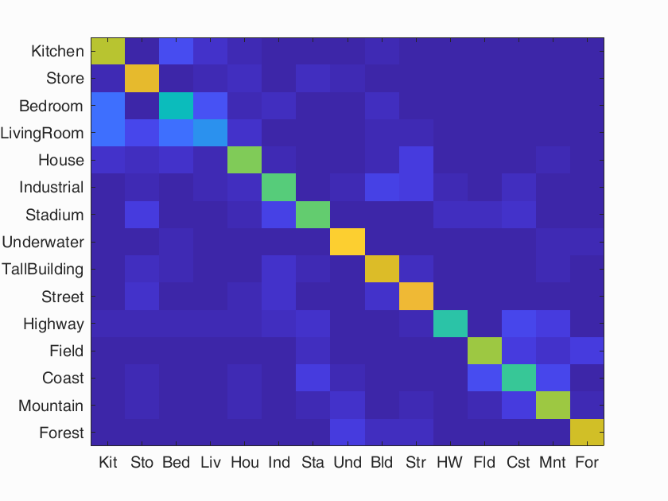
Bag of SIFT with colour images (SVM)
Accuracy: 66.3%
Strongest Cat: Underwater: 89%
Weakest Cat: Living Room: 32%

Slide 12
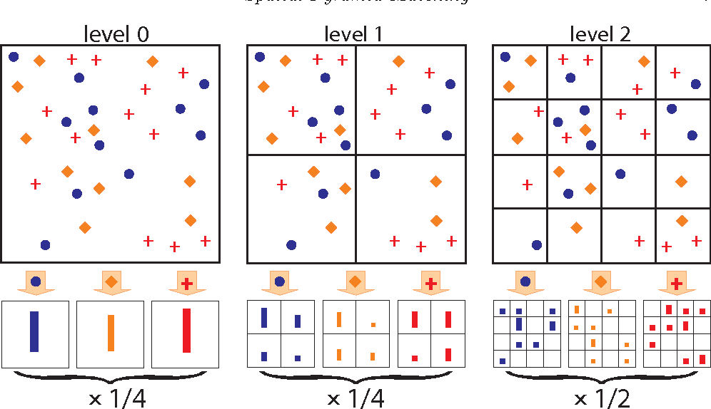
Spatial Pyramids
The image is split into 4^level quadrants where “level” increases by intervals of 1 and SIFT features for these sub-images are generated and added to the feature.
The resulting sub-images are (1x1, 2x2, 4x4, etc.).
In the case of RGB Spatial Pyramids, the red, green and blue intensities are split and SIFT features are generated for each segmented image.
Lazebnik, 1970

Slide 13

Spatial Pyramids with grayscale images (KNN)
Accuracy: 57.4%
Strongest Cat: Forest: 89%
Weakest Cat: Mountain: 31%

Slide 14
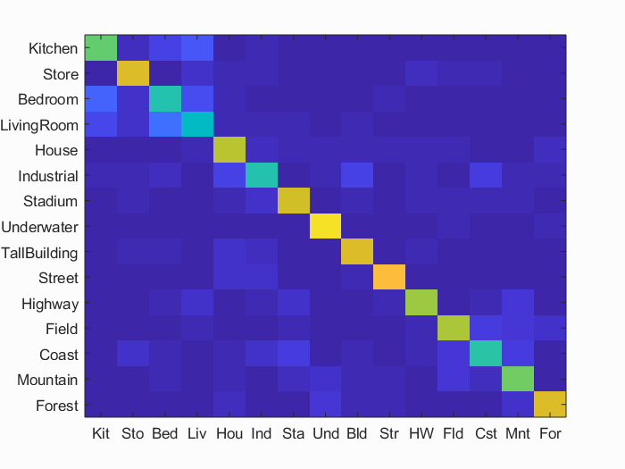
Spatial Pyramids with grayscale images (SVM)
Accuracy: 65.9%
Strongest Cat: Underwater: 86%
Weakest Cat: Living Room: 46%

Slide 15

Spatial Pyramids with colour images (KNN)
Accuracy: 60.9%
Strongest Cat: Underwater: 91%
Weakest Cat: Industrial: 33%

Slide 16
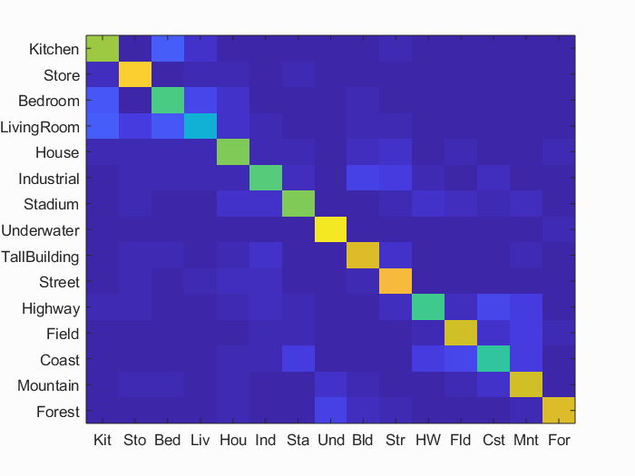
Spatial Pyramids with colour images (SVM)
Accuracy: 70.2%
Strongest Cat: Underwater: 95%
Weakest Cat: Living Room: 43%

Slide 17
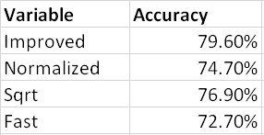
Fisher
Similar to Bag of SIFT
Storing visual word occurrences only.
Representations store statistics of the difference between dictionary elements and pooled local features.
Uses GMM rather than KMeans for dictionary creation.
Different variables can be adjusted:
Normalized
SquareRoot
Improved
Fast

Slide 18
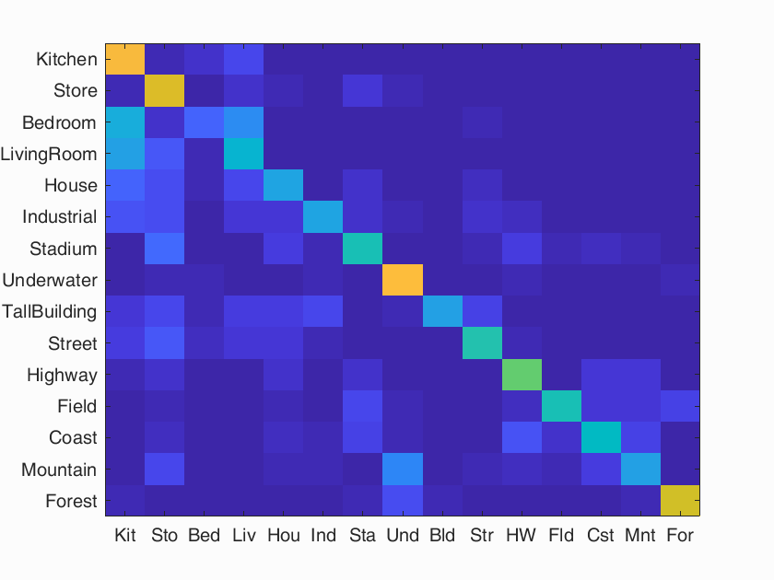
Fisher with grayscale (KNN)
Accuracy: 52.9%
Strongest Cat: Underwater: 83%
Weakest Cat: Bedroom: 19%

Slide 19
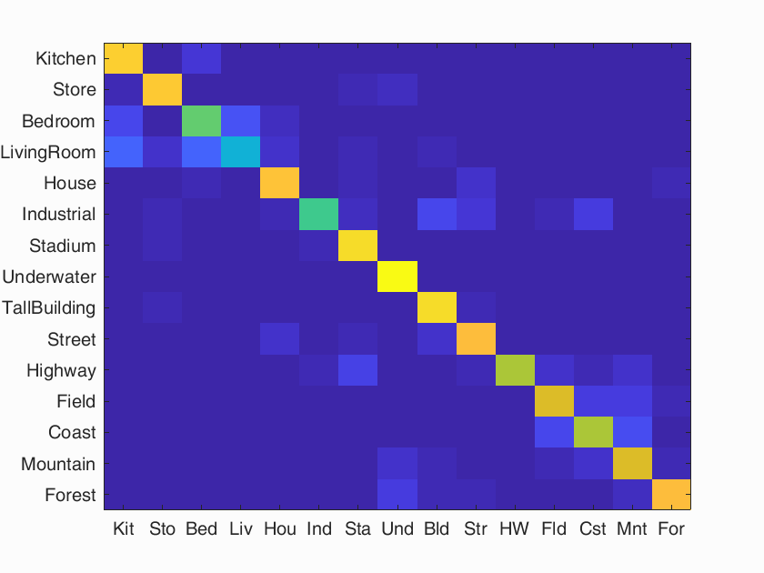
Fisher with grayscale (SVM)
Accuracy: 79.6%
Strongest Cat: Underwater: 99%
Weakest Cat: LivingRoom: 43%

Slide 20
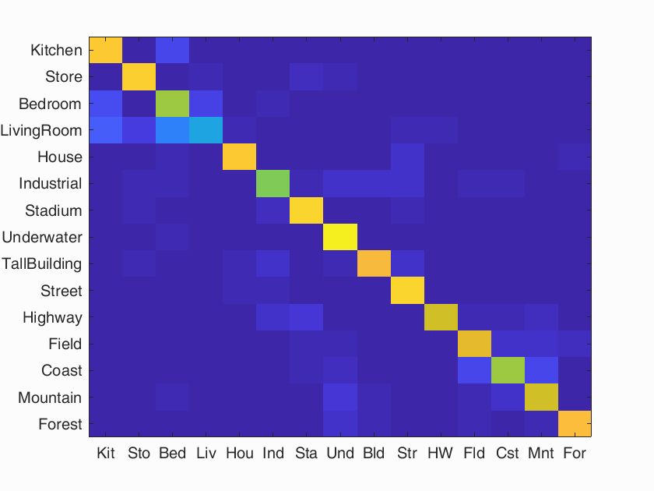
Fisher with colour (SVM)
Accuracy: 78.5%
Strongest Cat: Underwater: 96%
Weakest Cat: LivingRoom: 38%

Slide 21
Conclusions

Slide 22
References
Lazebnik, Svetlana. “1 Spatial Pyramid Matching.” Semantic Scholar, 1 Jan. 1970, www.semanticscholar.org/paper/1-Spatial-Pyramid-Matching-Lazebnik/ba8e0bda11af08b6037666b67cf54ae1f780822d.
Sanjay.M. “KNN Using Scikit-Learn.” Towards Data Science, Towards Data Science, 26 Oct. 2018, www.towardsdatascience.com/knn-using-scikit-learn-c6bed765be75.

